Slide 1
DIGITAL PORTFOLIO
Student Name:V.Kaviya
Register No And NMID:asbrubd2428k0033
Department:BSC CS (AI&DS)
College: Venkateshvara arts and science college
Add your text

Slide 2
PROJECT TITLE
STUDENT PORTFOLIO

Slide 3
📋 AGENDA
Problem Statement
Project Overview
End Users
Tools and Technologies
5. Portfolio design and Layout
6. Features and Functionality
7. Results and Screenshot
8. Conclusion
9.Githup Link

Slide 4
💡PROBLEM STATEMENT
In today’s competitive academic and professional environment, students need a structured and accessible way to showcase their skills, achievements, and learning experiences. Traditional resumes and paper-based profiles often fail to fully represent a student’s abilities, creativity, and growth over time. Employers, educators, and peers increasingly expect digital platforms that highlight both technical and personal competencies.

Slide 5
📝 PROJECT OVERVIEW
The Student Portfolio project aims to create a digital platform where students can effectively showcase their academic achievements, skills, projects, and extracurricular activities in a structured and visually appealing manner. It serves as a personal branding tool, providing educators, peers, and potential employers with a clear understanding of the student’s capabilities and growth. The portfolio can be accessed online , ensuring easy sharing and accessibility.

Slide 6
🧑🏻‍💻 END USERS
The end users of a student portfolio include the students themselves, who create and maintain it to showcase their skills, projects, and achievements, as well as educators who use it to assess progress and provide feedback. Potential employers and recruiters also access the portfolio to evaluate qualifications for internships, jobs, or other opportunities, and career counselors can use it to guide students effectively.

Slide 7
⚒️ TOOLS AND TECHNOLOGIES
1. Frontend Technologies – HTML, CSS, JavaScript, React, Angular
2. Styling Tools – Bootstrap, Tailwind CSS
3. Version Control & Collaboration – GitHub, GitLab, Bitbucket
4. Cloud Storage – Google Drive, OneDrive
5. Hosting Platforms – Netlify, Vercel, GitHub Pages

Slide 8
🎨 PORTFOLIO DESIGN AND LAYOUT
A well-structured student portfolio design typically begins with a clean header featuring the student’s name and navigation menu, followed by a hero section with a short introduction, tagline, and a call-to-action like “View Projects” or “Download Resume.” It should also include an “About Me” section to highlight academic background and career goals. A dedicated projects section can showcase work with images, descriptions, and links. Finally, a skills area with simple icons or progress bars helps demonstrate technical strengths in a visually engaging way.

Slide 9
FEATURES AND FUNCTIONALITY
🔹 Responsive Design :
The portfolio should be accessible across all devices with a clean, user-friendly layout.
🔹 Navigation :
A well-structured navigation menu ensures smooth movement between sections.
🔹 Projects Showcase :
Displays work using interactive cards with images, descriptions, and links to live demos or GitHub repositories.
🔹 Skills Section :
Visually represents technical expertise with progress bars, icons, or badges for clarity.

Slide 10
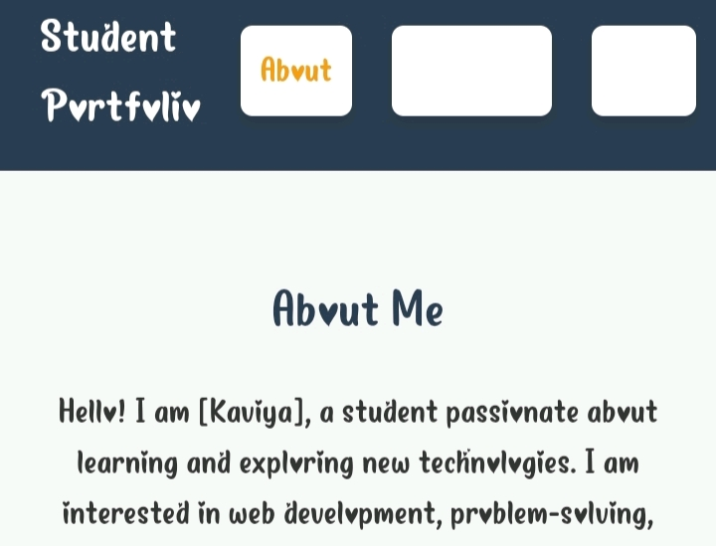
RESULTS AND SCREENSHOTS

Slide 11
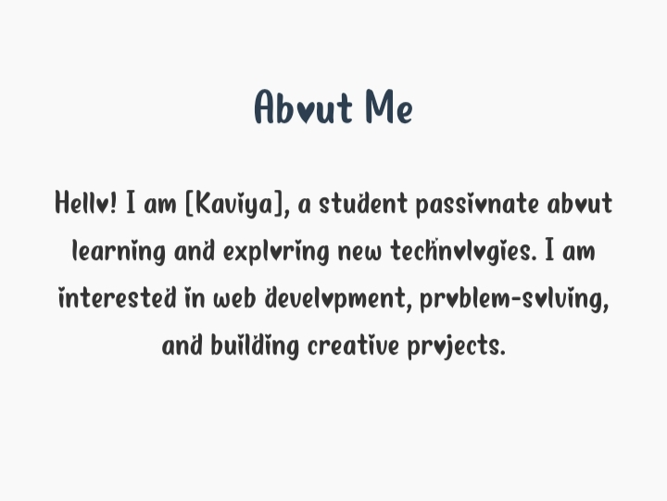

Slide 12
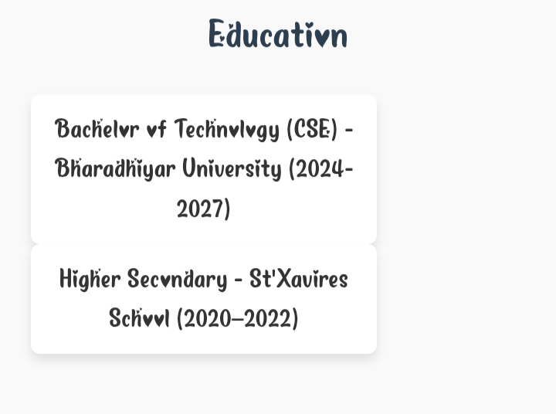

Slide 13
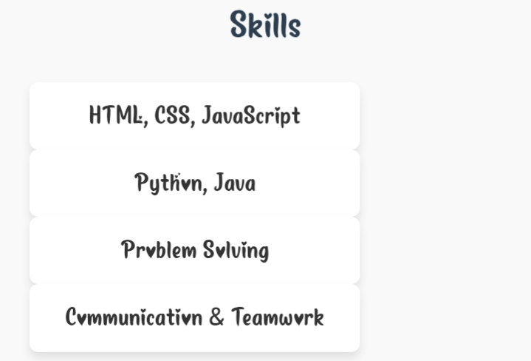

Slide 14
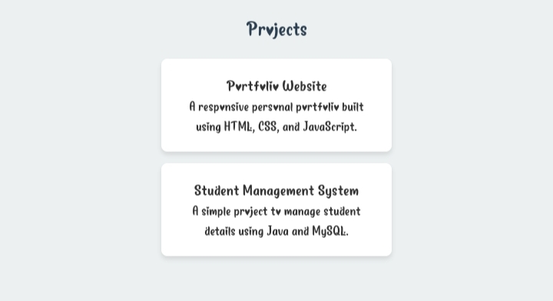

Slide 15
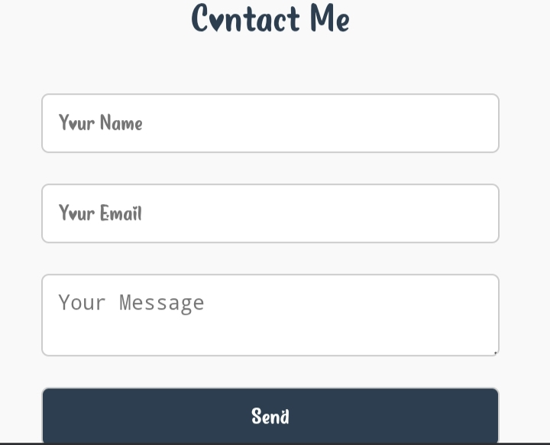

Slide 16
📌CONCLUSION
A student portfolio is a valuable tool that effectively showcases a student’s skills, projects, achievements, and personal growth in a professional and organized manner, helping to build a strong personal brand and enhance opportunities for internships, jobs, or further studies. It also reflects creativity and dedication.Overall,it serves as a comprehensive representation of a student's abilities and potential.

Slide 17
🔗GITHUP LINK
https://github.com/kaviyavigneshvaran-beep/KaviyaTNSDC-FWWD-DP.git

Slide 18
THANK
YOU

